Slide 1

Capstone Project On E-commerce (BA) Presentation
International
Institute of Information
Technology Bangalore
By
Revathy Menon,
Abhishek Chauhan,
Anuja Patil

Slide 2
AGENDA
Company Overview
Business Challenges
Spin Selling Framework
Business Objective
Data Preparation, Cleaning and Analysis
Feature Engineering
Exploratory Data Analysis
Model Building and Evaluation
Model Equation
Recommendations

Slide 3
Company Overview
ElecKart is a leading Ontario-based e-commerce marketplace specializing in electronic products such as TVs, cameras, OLED screens, and microwaves. It operates on a marketplace model, acting as a platform that connects buyers and sellers, offering a wide range of both premium and budget-friendly brands.
The company operates exclusively through its website and runs large-scale promotional events to attract high-value customers. ElecKart has built a nationwide delivery network by partnering with multiple courier services. Robust quality checks and real-time order tracking enhance the delivery experience. Customer feedback is actively collected to continuously improve service quality and satisfaction.
Category Managers | Curate product assortments, optimize listings, and enhance user navigation for a superior browsing experience.
Onboard Team | Authenticates and onboards verified sellers, ensuring high-quality inventory and reliable partners.
Sellers | Supply goods listed on the platform, managing their inventory and ensuring product availability. ElecKart maintains a zero-inventory model.
Warehouses | Used for quality-controlled storage and direct shipment, ensuring products meet our standards before reaching the customer.
Logistics Partners | Handle nationwide deliveries, efficient returns processing, and secure Cash on Delivery (COD) payments.
Customer Care | Resolves post-sale issues promptly and provides comprehensive support to both customers and merchants.

Slide 4
Company Overview – Marketplace Model
Seller Onboarding
Product Listing
Fulfilment & Delivery
Customer Purchase
Post-Sale Support
Rigorous authentication and verification of new sellers
Customer Care resolves issues for both buyers and sellers
Sellers upload products; Category Managers curate and optimize
Buyers browse, select, and complete transactions on our platform
Logistics partners handle nationwide, quality-checked delivery

Slide 5
Business Challenges
ElecKart had commendable early growth, but revenue declined in the past year despite significant investments in marketing
High customer churn resulted from a lack of understanding of customer needs
Underwhelming user experience due to the absence of a mobile app, and a confusing website with incomplete product details.
The marketing budget proved ineffective, prompting the CFO to request a root cause analysis to uncover operational inefficiencies

Slide 6
SPIN Selling Framework
After conducting a root cause analysis, the team met ElecKart’s Head of Marketing to validate insights. The discussion revealed that low conversion rates and short user sessions point to major UX flaws. This exchange helped frame the deeper business implications—customer loss, stock inefficiency, and declining turnover.
Based on conversation SPIN Selling Framework is mentioned below.

Slide 7
Business Objective
Following our root cause analysis, we identified the absence of market mix modeling (MMM) as a key issue behind ElecKart's suboptimal marketing ROI
MMM is essential for quantifying the impact of various marketing channels and external factors on sales
The scope of analysis was based on transactional and external data from July 2015 to June 2016.

Slide 8
Data Preparation, Cleaning and Analysis
We will be creating market mix models for three product subcategories: Camera Accessory, Home Audio, and Gaming Accessory and providing recommendation to the business.
Importing required libraries | Imported pandas, numpy, seaborn etc in Google colab
Importing required datasets | Imported consumer electronics data, media data, climate data, product details, special sale calendar and NPS data
Removed duplicate data | All the rows with duplicate data were deleted
Dropped insignificant columns | Removed columns with single values, as well as unique ‘ID’ columns
Corrected datatypes | Converted columns to appropriate datatypes
Treatment of null values | Rows with null values were either removed or imputed with zero/appropriate values
Treatment of outliers | Capped the outliers in consumer electronics to 1st and 99th percentile
Filtered the data | Filtered the rows for the specified dataframe – July 2015 – June 2016
Weekly aggregation of dataframes | The individual dataframes for camera accessory, gaming accessory and home audio was aggregated into weekly data by creating a function for that
Data modelling | The dataframes were scaled (using fit and transform). Applied log transformation for multiplicative models

Slide 9
Feature engineering
Created new column for week
Created new columns to identify the day of the week and the day number
Created columns to identify the pay day and the pay day week
Created columns to recognize public holidays and holiday week in Canada as gmv will be higher during festivals
Created column to identify premium products
Calculated the sales price and discount for premium products
Created lag variables for distributive lag models
Created a week function to convert monthly data to weekly data to align with the consumer dataset
Filtered data containing the required subcategories-Camera Accessory, Home Audio, and Gaming Accessory
Created weekly dataset for media investment and climate data using the dictionary created for 2015 and 2016
Separated the data frame for 2015, 2015-2016 and 2016
Executed dummy encoding for certain categorical variables
Merged all the dataframes using the column ‘Week’
9

Slide 10
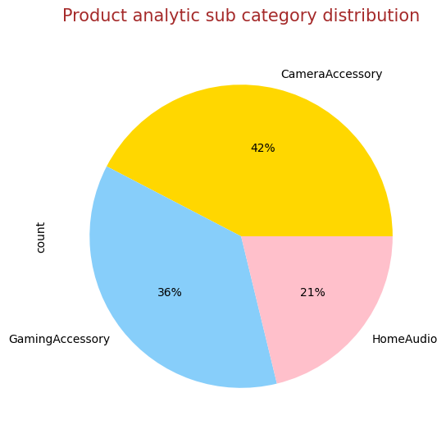
Exploratory Data Analysis
Camera accessories are ordered the most, followed by gaming accessories and home audio
10

Slide 11
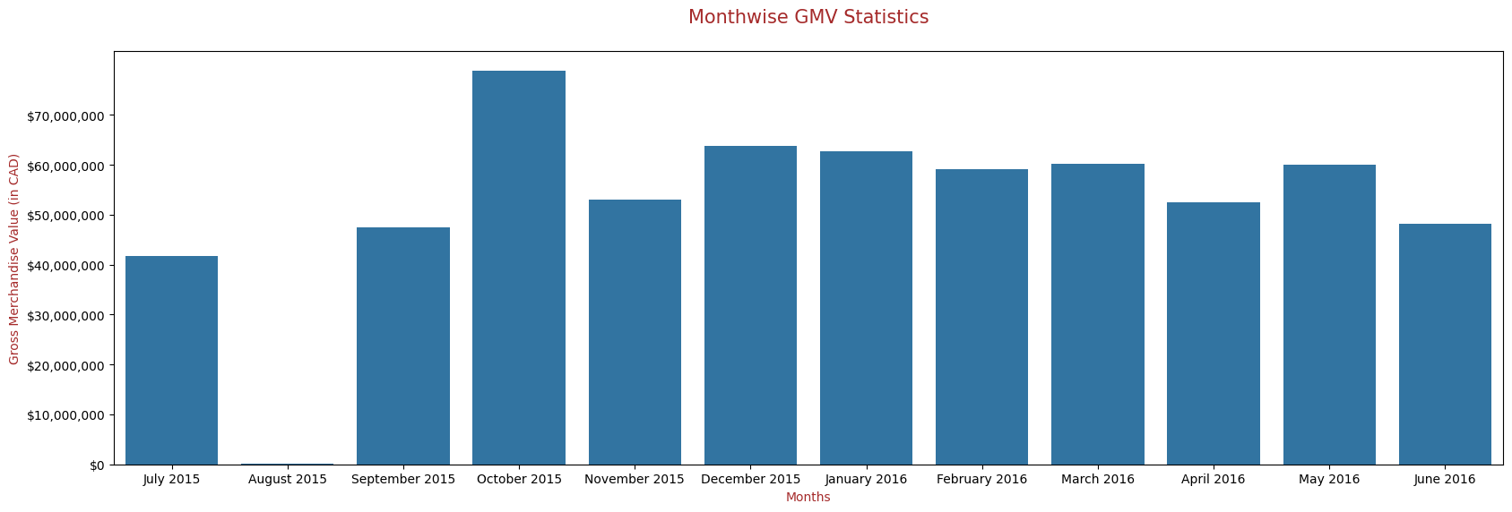
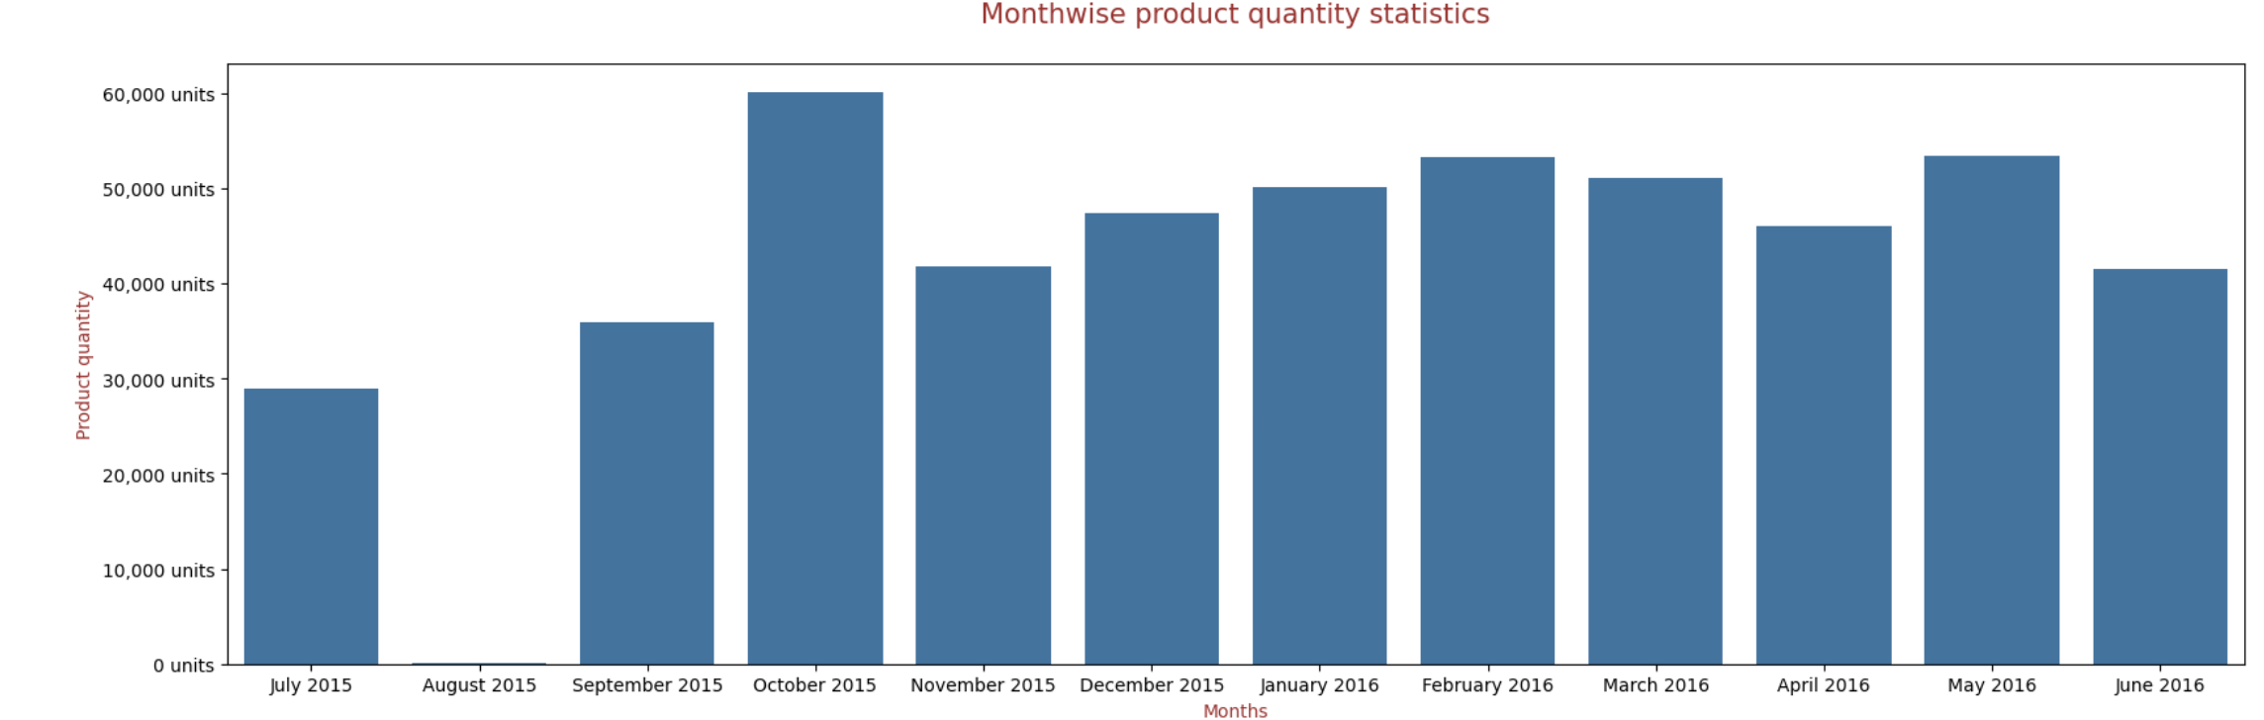
Exploratory Data Analysis
Plotted month-wise statistics of revenue and quantity ordered
October and December recorded the highest gmv as these months contain a lot of festivals and holidays
Least gmv is observed in August¶
Maximum sales is recorded in October, followed by May
Least sales is observed in August
11

Slide 12
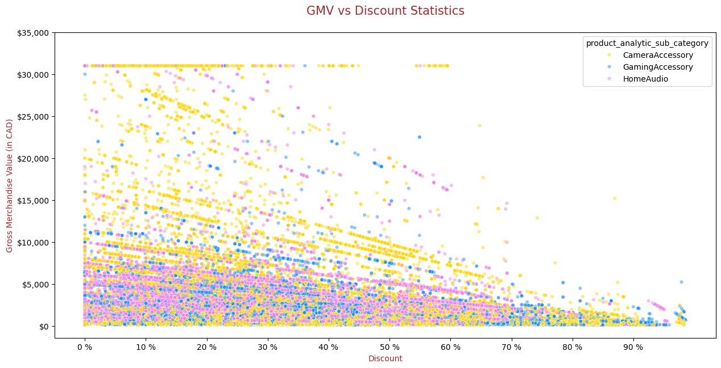
Exploratory Data Analysis
Revenue tends to be high for products with discount percentage ranging from 0 to 60%. Post 60% discount, revenue starts declining
12

Slide 13
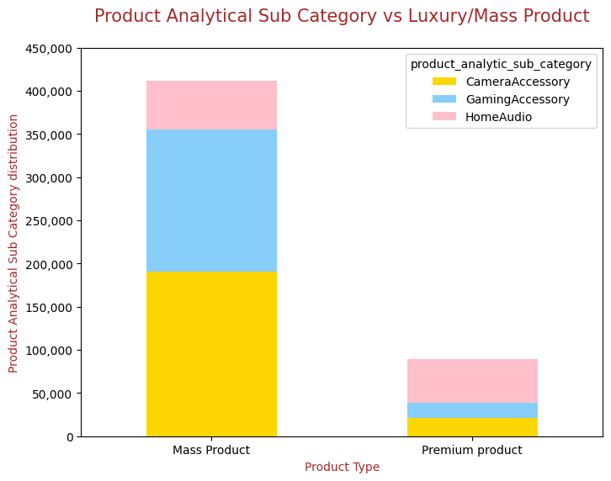
Exploratory Data Analysis
Premium products are those products that are priced above 1999
Orders for mass products are much higher than that of premium products
Among mass products, camera accessories were sold the most, whereas among premium products, homeaudio products were sold the most
13

Slide 14
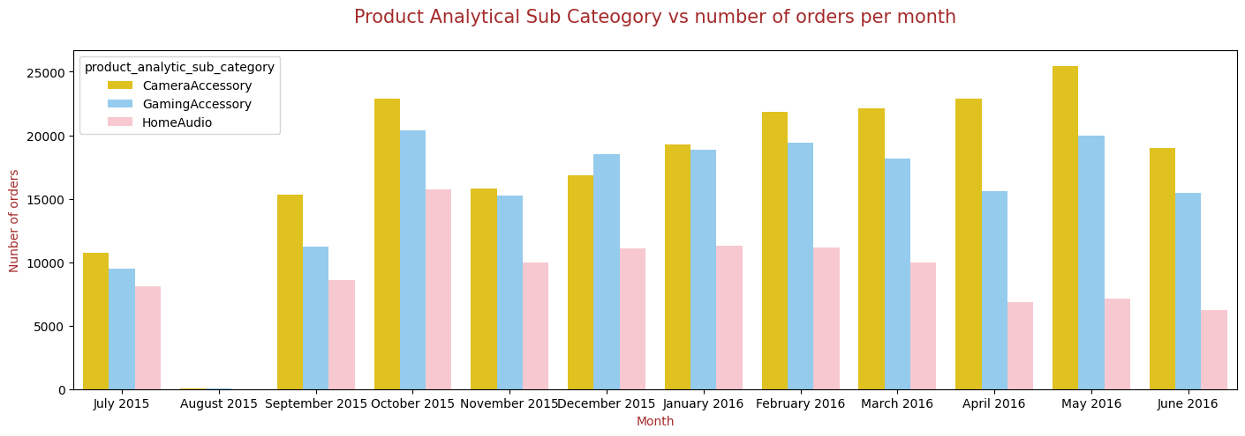
Exploratory Data Analysis
Maximum orders for camera and gaming accessories are placed in October and May
Home audio products are least ordered in April, May and June
14

Slide 15
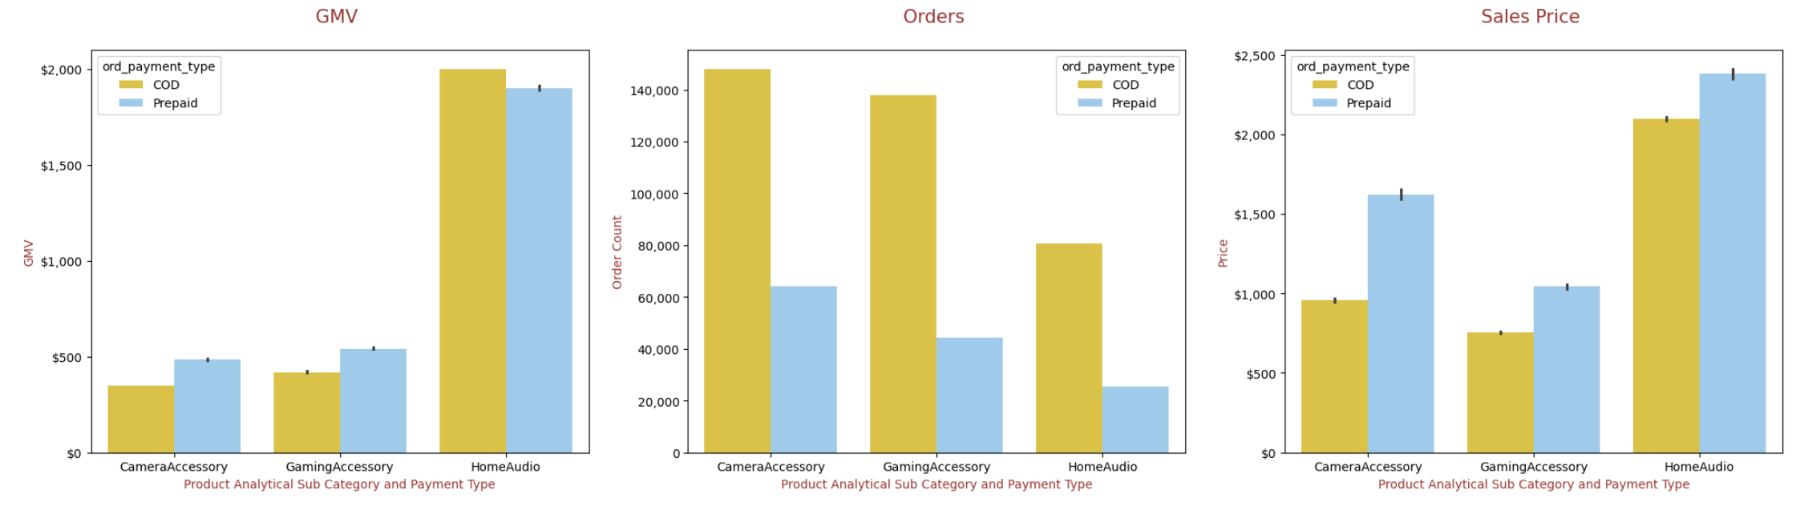
Exploratory Data Analysis
Highest revenue is generated from homeaudio products
Highest number of orders are placed for camera accessories. Products are ordered more on COD than prepaid
Sales price for HomeAudio products are higher than the other 2 categories. Sales generated from prepaid orders are more than COD

Slide 16
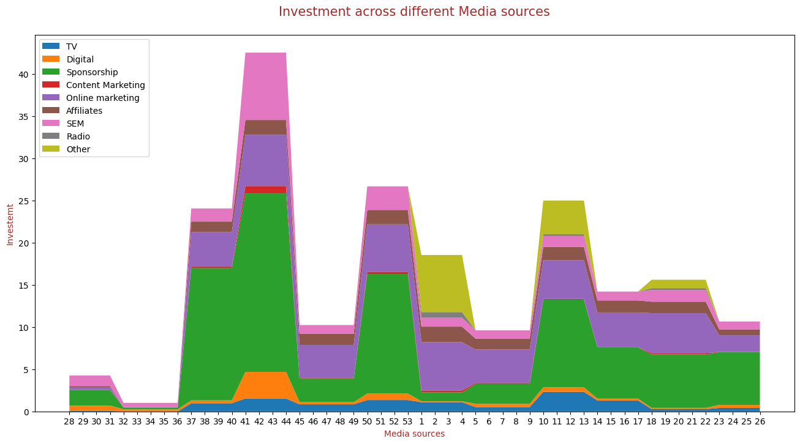
Exploratory Data Analysis
Investment across different Media sources
16

Slide 17
Model Building and Evaluation
For all the five models, below steps were executed for the three sub-categories:
Train test split
Separating X and y train sets(Dependent and target variables)
Log transformation for multiplicative models
Rescaling the features using standard scaler
Creating lag variables for Koyck, Distributive lag (Additive) model and Distributive lag (Multiplicative) model
Building a linear regression model
Building Linear Regression model using K-fold Cross Validation
Calculating NRMSE
Plotting the feature importance
17

Slide 18
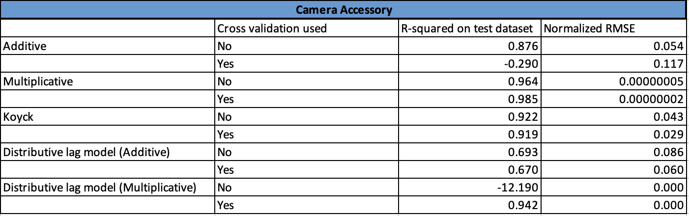
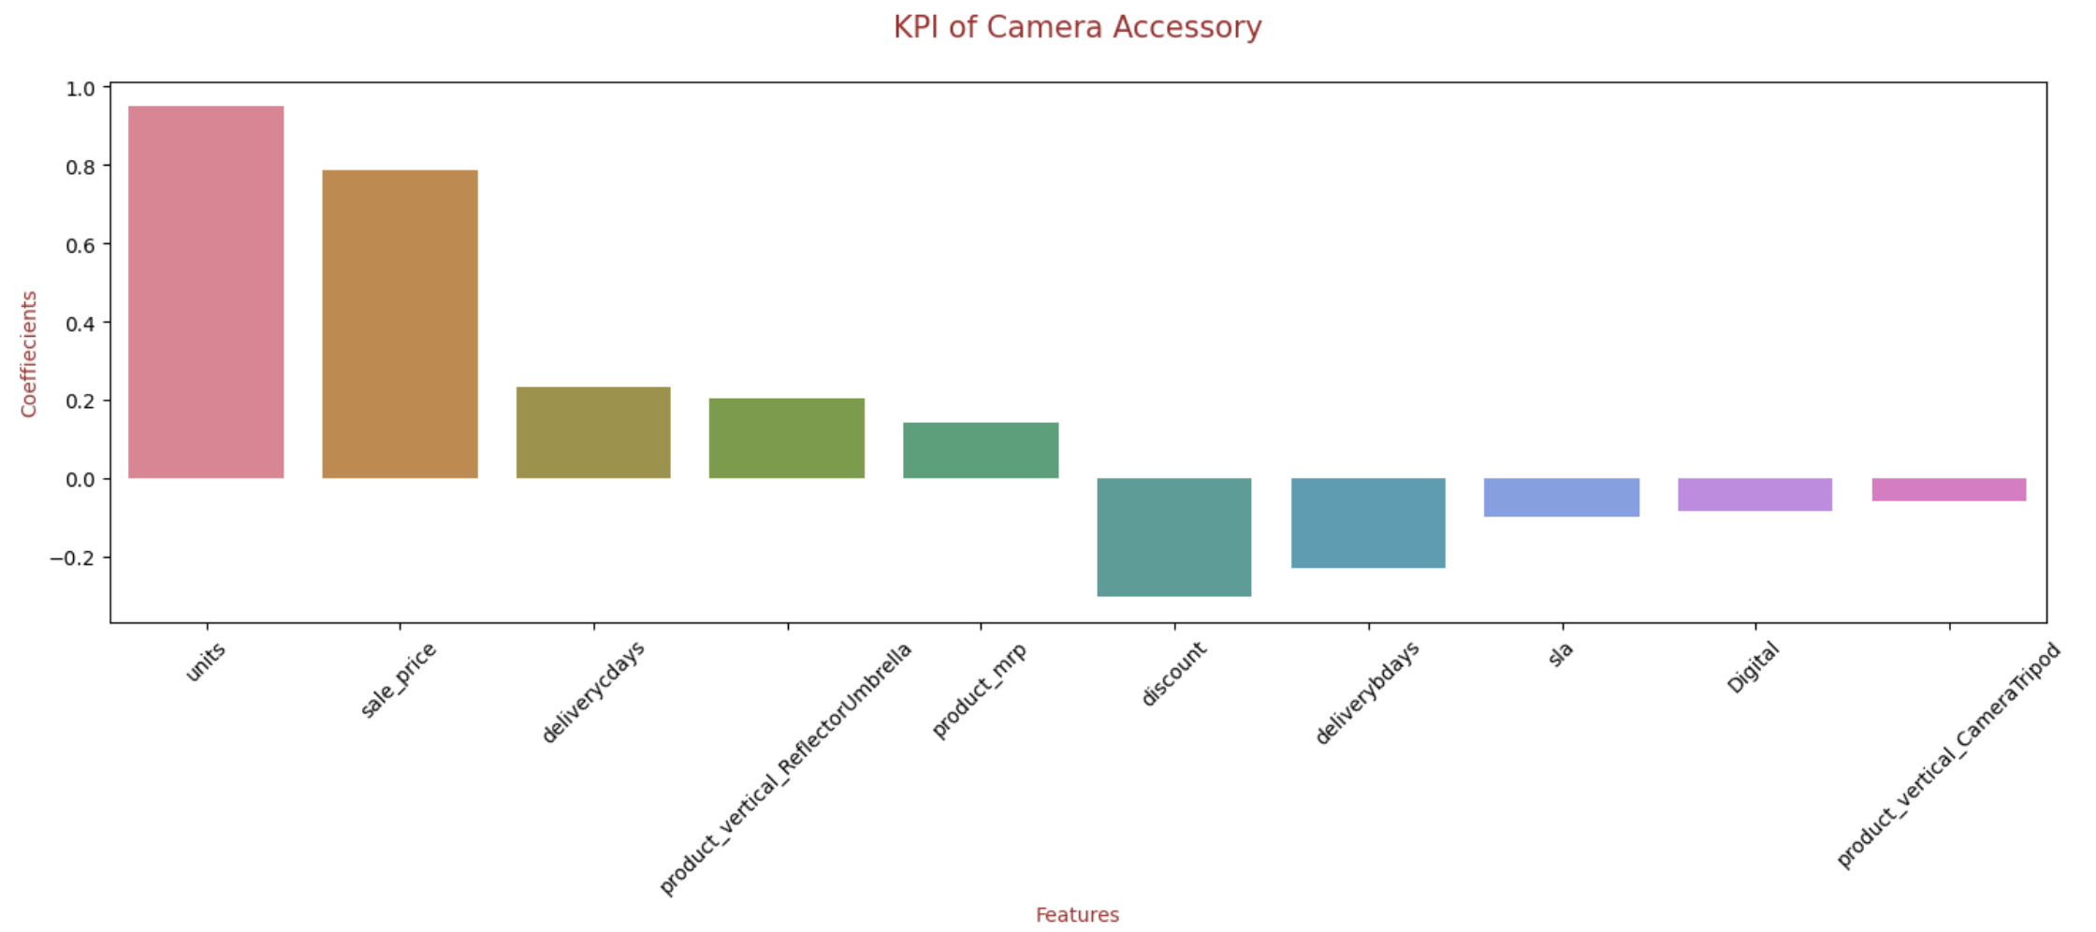
Camera
Accessories
We have chosen multiplicative model with an accuracy of 96%
The top 10 KPIs (top 5-positively correlated and top 5 negatively correlated) that has been used in the model equation are shown in the second figure

Slide 19
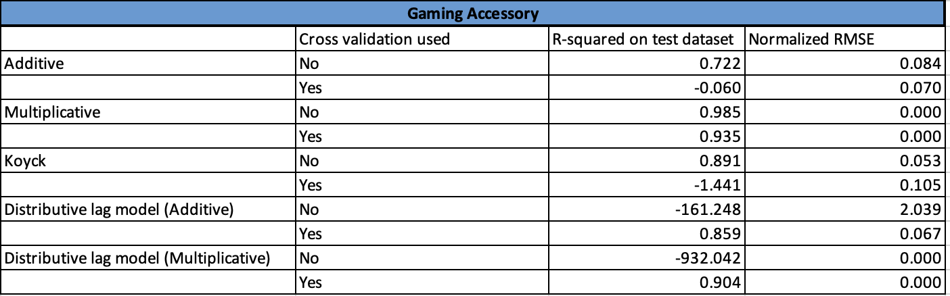
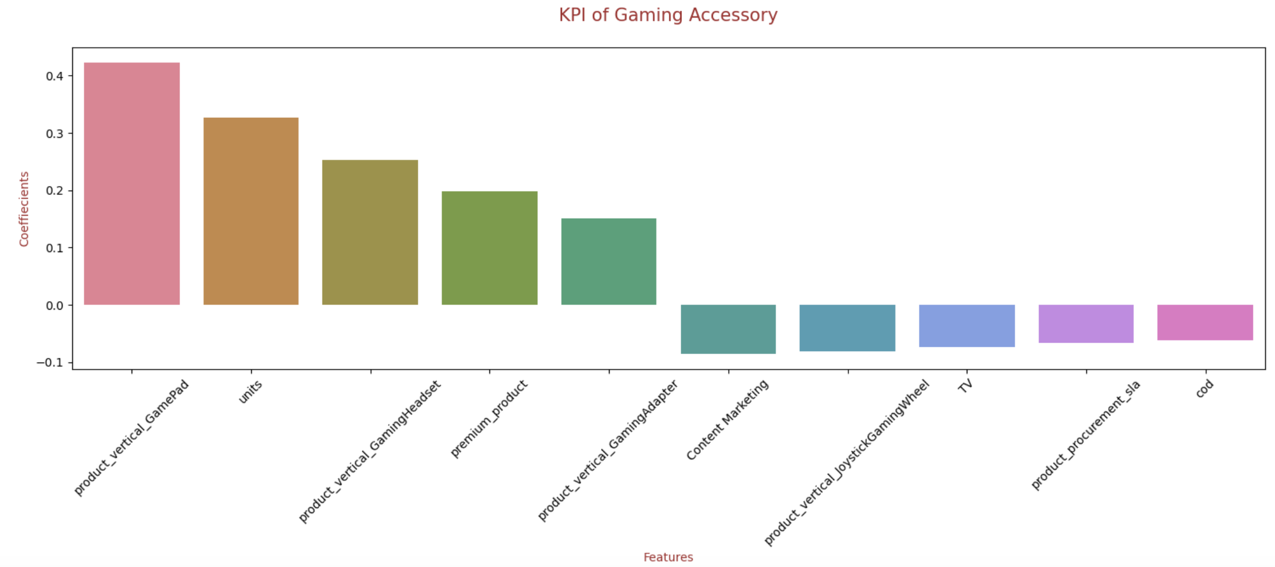
Gaming
Accessories
We have chosen multiplicative model with an accuracy of 98%
The top 10 KPIs (top 5-positively correlated and top 5 negatively correlated) that has been used in the model equation are shown in the second figure

Slide 20
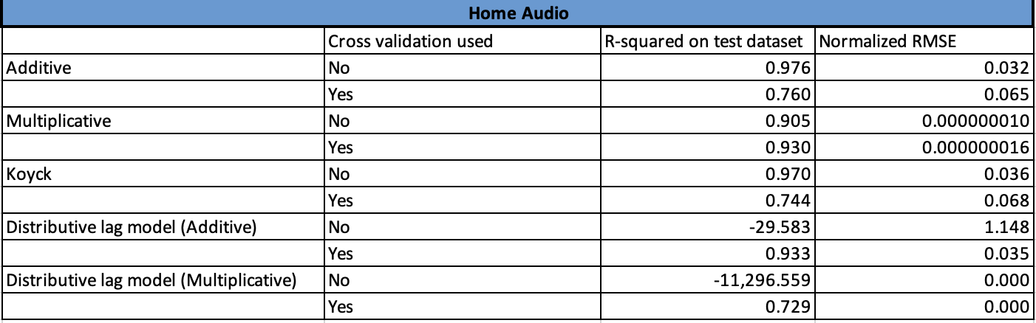
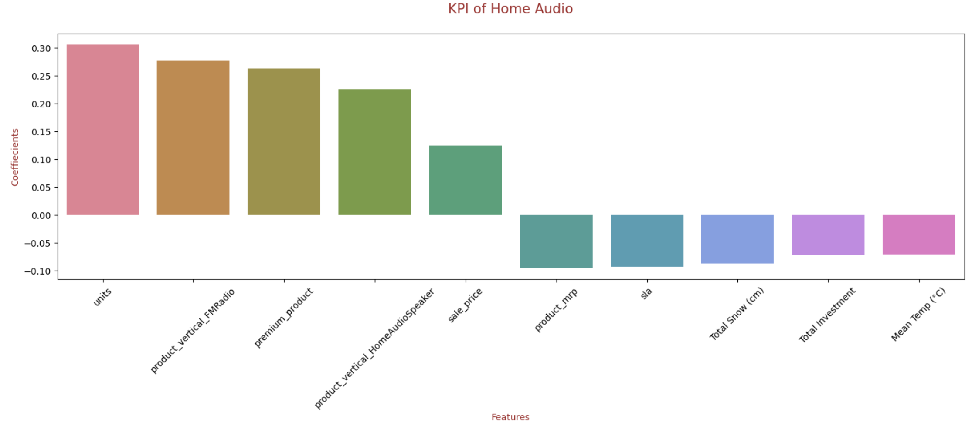
Home Audio
We have chosen multiplicative model with an accuracy of 93%
The top 10 KPIs (top 5-positively correlated and top 5 negatively correlated) that has been used in the model equation are shown in the second figure

Slide 21
Model Equation
For the purpose of this project, we will be selecting the top 10 KPIs for each product sub-category (5 highly positive/negative)
The equation for the best fit line for all the three product sub categories is as follows:-
Camera Accessory gmv = (0.951 X units) + (0.787 X sale_price) + (0.234 X deliverycdays) + (0.203 X product_vertical_ReflectorUmbrella) + (0.142 X product_mrp) + (-0.304 X discount ) + (-0.228 X deliverybdays) + (-0.099 X sla) + (-0.085 X Digital) + (-0.058 X product_vertical_CameraTripod)
Gaming Accessory gmv = (0.423 X product_vertical_GamePad) + (0.327 X units) + (0.252 X product_vertical_GamingHeadset) + (0.198 X premium_product) + (0.151 X product_vertical_GamingAdapter) + (-0.086 X Content Marketing) + (-0.081 X Tproduct_vertical_JoystickGamingWheel) + (-0.074 X TV) + (-0.067 X product_procurement_sla) + (-0.062 X cod)
Home Audio gmv = (0.305 X units) + (0.276 X product_vertical_FMRadio) + (0.262 X premium_product) + (0.225 X product_vertical_HomeAudioSpeaker) + (0.125 X sale_price) + (-0.095X product_mrp) + (-0.093 X sla) + (-0.087 X Total Snow (cm)) + (-0.072 X Total Investment) + (-0.071 X Mean Temp (°C))

Slide 22
Recommendation

Slide 23
Camera Accessory:
Product Vertical Reflector Umbrella with price above 2000 CAD contribute to high revenue. So, company should focus on the availability and marketing of these products.
Customers tend to order products which minimum sla/ delivery days. So, company should focus on efficient warehousing and ensure that the product stock is sufficient in the nearest warehouse of the region where orders are high.
Company should revisit the digital marketing strategies
Gaming Accessory:
Products like Game Pad, Gaming Headset, Gaming Adapter and premium products contribute positively to revenue. So, company should focus on availability and marketing of these products.
Customers tend to order products with minimum sla, hence they should focus on logistics and warehousing 3.Company should revisit the content marketing strategies and TV ads as they have negatively impacted the revenue.
Home Audio:
Products like Radio, Gaming Headset, Speaker and premium products contribute positively to revenue. So, company should focus on availability and marketing of these products
During high snow, the demand for home audio products are low, so company can provide discount during this period and gain customers.
Customers tend to order products with minimum sla, hence they should focus on logistics and warehousing
Company should revisit its investment strategies as it has negatively impacted the revenue.

Slide 24
THANK YOU

